Slide 1


Haptic display for a wearable human-robot interface
Student : Hugo Kohli Professor : Dario Floreano First assistant : Matteo Macchini Second assistant : Carine Rognon

Slide 2
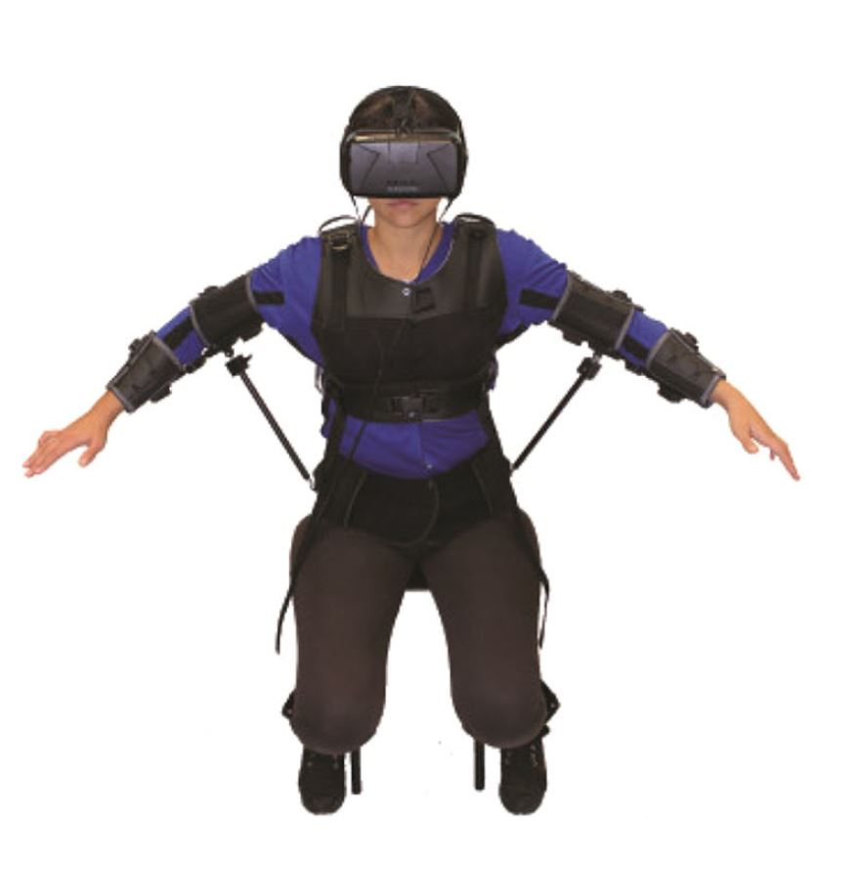



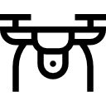
Motivations
1
Introduction
Integrate guidance in the FlyJacket
2
Work done
[1]
3
Future work
Infos about obstacles
transmitted
to the pilot
[1] Rognon et al. (2018), FlyJacket: An Upper Body Soft Exoskeleton for Immersive Drone Control
Notes:
What we wish to accomplish for this project is to integrate guidance in the fly jacket
The idea is to transmit informatino about the environnement to the pilot to facilitate obstacles avoidance

Slide 3
Approach
1
Introduction
Visual sensory channel overloaded
2
Work done
Alternative feedback
Haptic display :
9 vibrating DC motors in contact with the skin
1
2
3
Future work
3
Notes:
As the pilot has already a visual channel which is used either for piloting, or for controling instrument mounted on the drone such as cameras, We propose in this project an alternative feedback
Direction felt thanks to a succession of vibration
Possible applications:
Blind navigation
Sensory channel overload (exploit another channel) easy to
Pilot controling instrument mounted on the drone

Slide 4
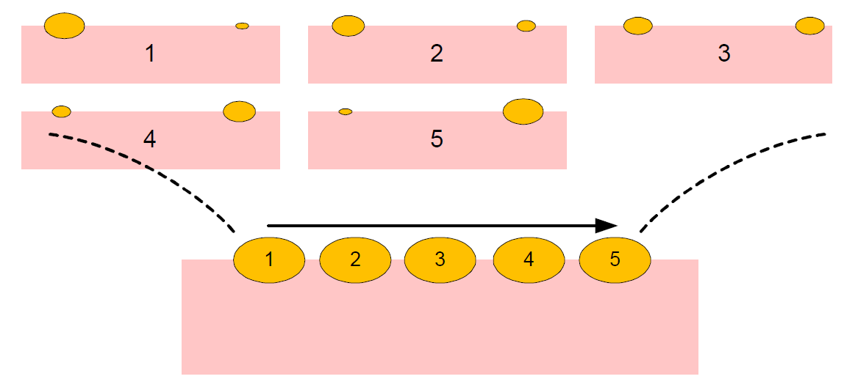
State of the art
1
Introduction
Funelling illusion
2
Work done
[2]
[3]
3
Future work
Allow to feel a continuous displacement
[2] Barghout et al. (2009), Spatial Resolution of Vibrotactile Perception on the Human Forearm When Exploiting Funneling Illusion [3] Cha, Rahal, et El Saddik (2008), A Pilot Study on Simulating Continuous Sensation with Two Vibrating Motors
Notes:
This two works studied the funnelling illusion Having only few motors, funnelling illusion is the phenomena that make the user feel a stimulation at a location in between the two motors, this is done by playing with their intensity.
This two studies (on time for motors on the back, the other time on the forearm) proved that this illusion allowed to feel a very continous displacement, which will be exploited in our work

Slide 5
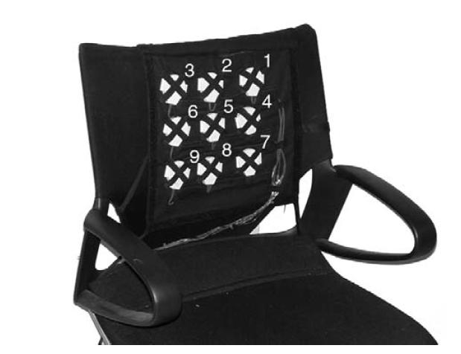
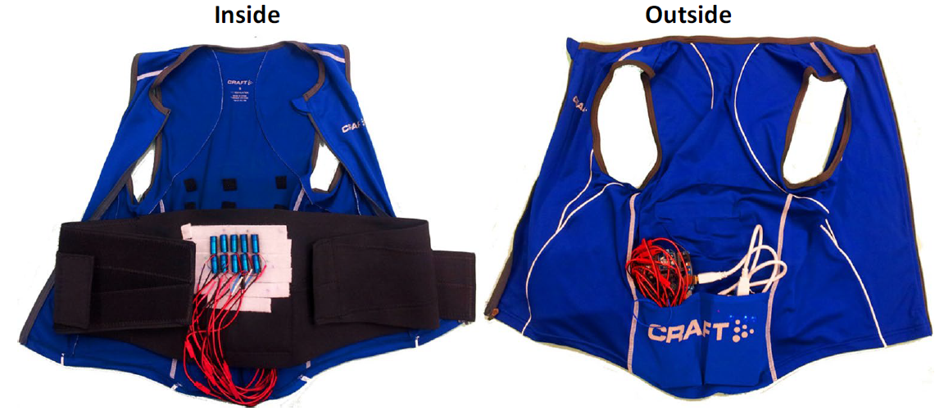
State of the art
1
Introduction
Wearable vibrotactile arrays :
2
Work done
[4]
[5]
3
Future work
Transmit direction information successfully
Simple step signals→ do not exploit funelling illusion
[4] Tan et ao. (2009), A Haptic Back Display for Attentional and Directional Cueing [5] Novich et Eagleman (2015), Using Space and Time to Encode Vibrotactile Information
Notes:
Then If we look at devices that use the same principle as our idea, we can find interesting result
They both use tactile array to transmit a direction pattern. And their results are promising because they proved that a naive subject was able to correctly identify the direction pattern most of the time
However, they both don’t exploit the funelling illusion as don’t switch several motors at the same time, so we expect to get more precise results
Tan et al. :device very similar to our goal (transmit a direction information), their study showed very promising results, as they observed that a naïve subject was able to identify correctly over 85% of the directions
3x3 array in a vest, testing different pattern Encoding information for deaf people Succession of step impulsion applied on the back Best results with spatio temporal [7]
Vest testing different way of using the array to transmit speech information to deaf people

Slide 6
Method
1
Introduction
Litterature review
Beagleboard integration
2
Work done
Prototype building
Experiments
Control of device
Analysis
3
Future work
Work done
Future work

Slide 7
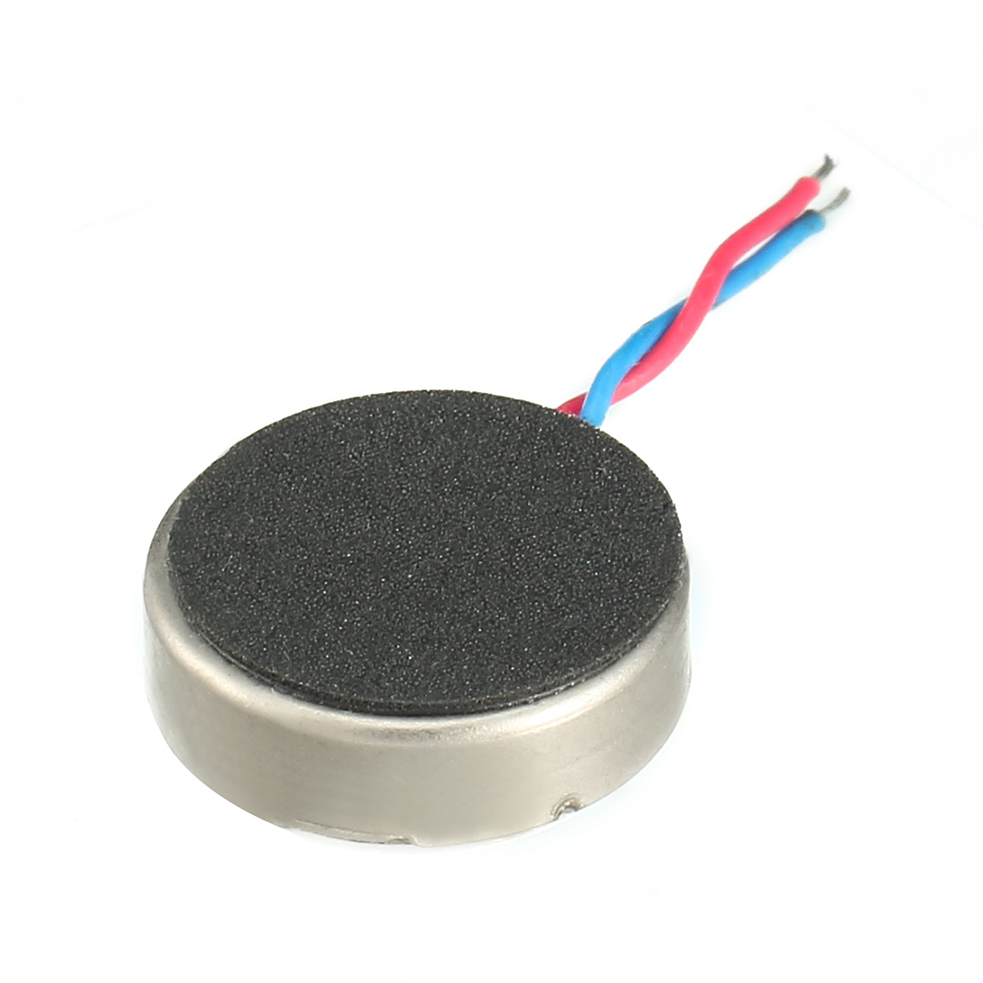
Prototype building
1
Introduction
1cm
9 coin DC vibrating motors
Fixed on fabric
2
Work done
Distance beween motors :
6cm
[3,4,5]
3
Future work
[3] Cha, Rahal, et El Saddik (2008), A Pilot Study on Simulating Continuous Sensation with Two Vibrating Motors [4] Tan et ao. (2009), A Haptic Back Display for Attentional and Directional Cueing [5] Novich et Eagleman (2015), Using Space and Time to Encode Vibrotactile Information
Notes:
So after I went through the littérature, it was time to create a first prototype.
We chose to take small dc vibrating motors as this one, and we fixed them on a piece of fabric.
According to the littérature, the distance between each motor is set to 6 cm.

Slide 8
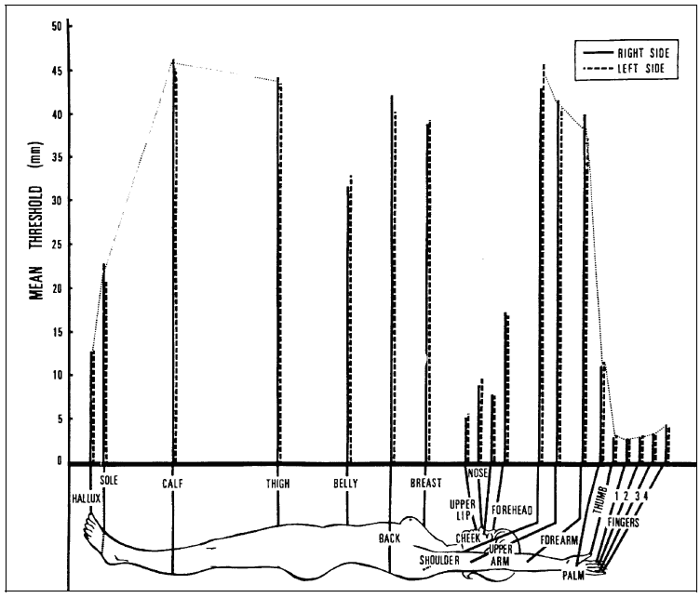
Prototype building
1
Introduction
Point of contact : belly
2
Work done
3
Future work
[6] Weinstein S. (1968) Intensive and extensive aspects of tactile sensitivity as a function of body part, sex, and laterality.
Notes:
The contact zone of the array with the skin will be the belly. Indeed, if we have a look at this graph that shows the two point distinction threshold on different body part, we can see that the belly is the lowest of the upper body, so it is supposed to be the most sensitive part of the upper body

Slide 9
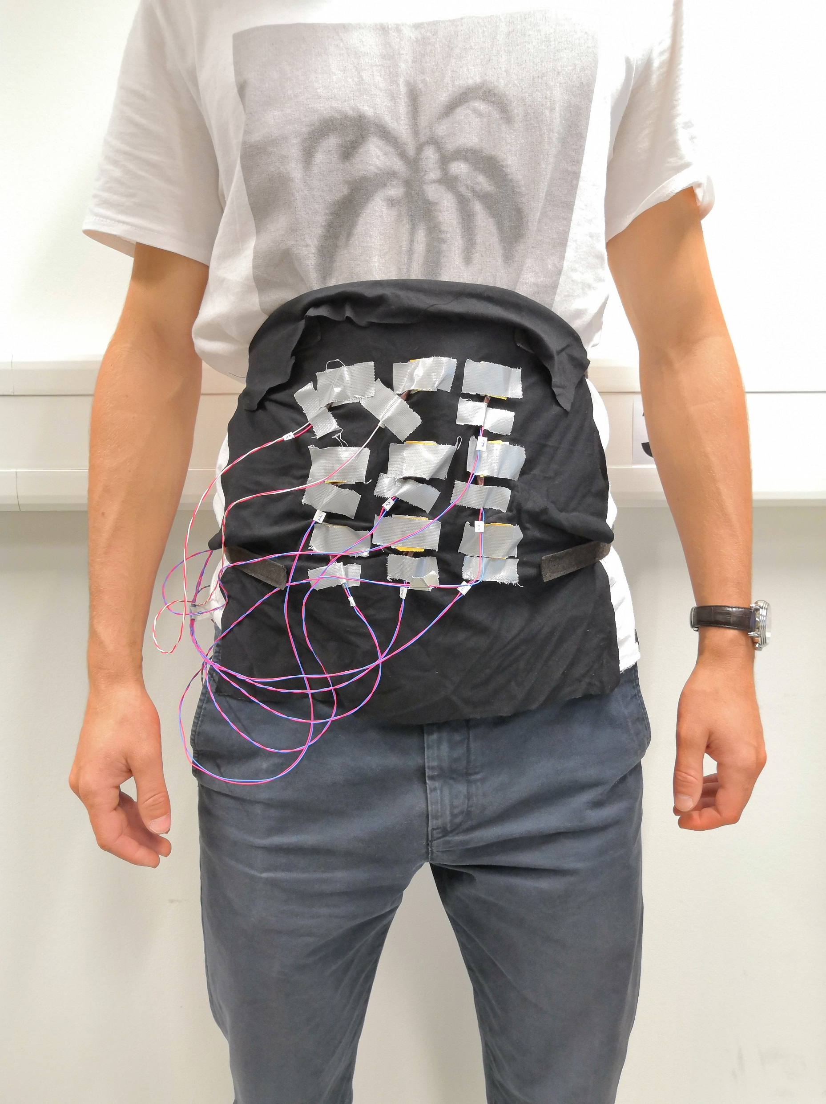
Prototype building
1
Introduction
2
Work done
3
Future work

Slide 10
Control of the haptic device
1
Introduction
Command the motors using the following variables :
Direction (N,S,E,W, NE, NW, etc…)
Maximum intensity of motors (duty cycle)
Length of pattern (ms)
Signal type (step or linear)
For now, only graphic feedback Next step : send command to PWM pins
2
Work done
3
Future work
Notes:
The control of the motors is coded in python, taking as input the direction, the type of the signal, its length and intensity. As I have implemented it on the micro controller yet, for now there is only a live graph showing each motor’s value

Slide 11
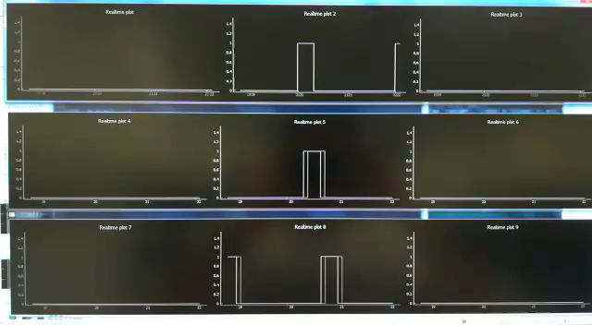
Control of the haptic device
1
Introduction
North, type of signal = step, lenght = 1, intensity 1
2
Work done
3
Future work

Slide 12
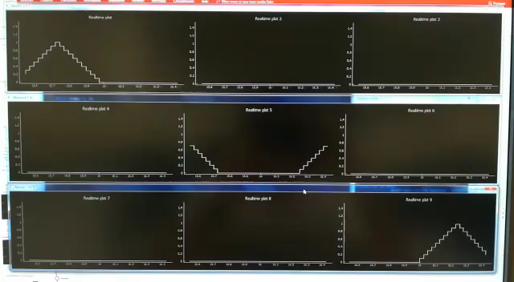
Control of the haptic device
1
Introduction
Southest, type of signal = linear, lenght = 1, intensity 1
2
Work done
3
Future work

Slide 13
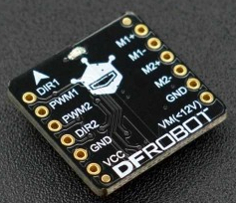
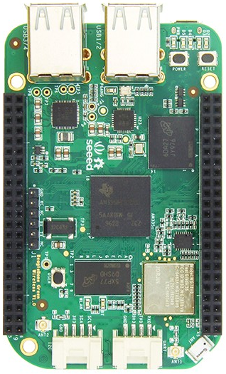
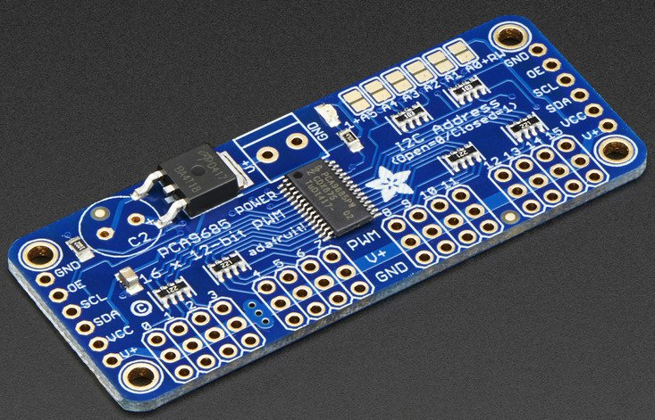

BeagleBoard integration
1
Introduction
2
Work done
BeagleBoard
I2C interface 16 PWM pins
Motors
3
Future work
DC motors drivers
PC
Notes:
The next step will be to first connect the motors to the micro controller. The motor will be controlled using PWM pins (to be able to modifiy their intensity). As the beagleboard only has only 8 PWM pins and we need to connect nine motors, we will use an I2C interface. Then we will also need some driver to deliver enough current for each motor

Slide 14


First experiment
1
Introduction
List of random directions
User identification
2
Work done
Goal : evaluate the correct identification rate Parameters tested : pattern length, motors max intensity, signal shape
3
Future work
Notes:
Once the motors will be functionning, we will perform a first experiment . We will determine which parameters give the best results
Goal : how accurate is the device, try the device, send them some patterns (ask them to recognize pattern) determine the most accurate pattern length, motors intensity and signal shape
→ send a list of directions and ask the user to give a feedback

Slide 15
Analysis
1
Introduction
Final step : analyse experiments datas
Create a final prototype :
More functionnal
More ergonomic
2
Work done
3
Future work
Notes:
First will determine which parameters give the best results

Slide 16
Thanks for your attention
Any questions ?

Slide 17


Second experiment
1
Introduction
Goal : exploit simulation data
Evaluate performance of the user :
with VS without haptic display
2
Work done
3
Future work
Notes:
Then, exploiting the datas from a simulator, we will compare the performances of the user with an without the haptic feedback

Slide 18
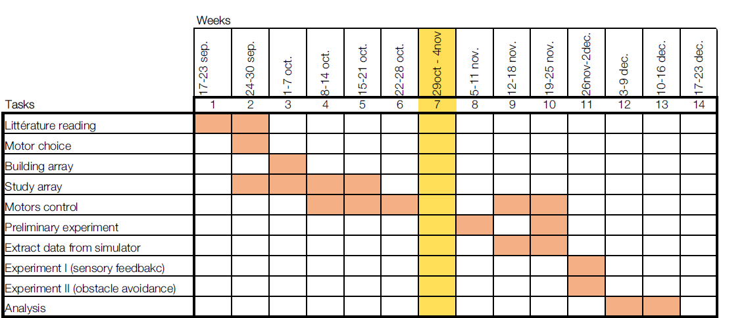
Gantt chart

